Slide 1

CMR COLLEGE OF ENGINEERING & TECHNOLOGY
MINI PROJECT
HAND GESTURE VOLUME CONTROLLER
By Batch 49:
Team Members: UNDER THE GUIDANCE OF
N.Raju(19H51A05E1) V.NARASIMHA
P.Saicharan(19H51A05E2) Assistant Professor
Adithya(19H51A05E6)

Slide 2
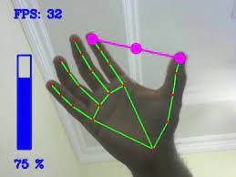
LIST OF CONTENTS
1)Abstract
2)Introduction
3)Objective
4)Scope and Limitations
5)Existing Method
6)System architecture
7)Result Images
8)Conclusion

Slide 3
Abstract
A hand gesture recognition system provides a natural, innovative and modern way of non verbal communication. It has a wide area of application in human computer interaction and sign language. The intention of this implementation is to discuss approach of hand gesture recognition based on detection of some shape based features. A primary goal of gesture recognition is to create a system which can identify specific human gestures and use them to convey information for device control and by implementing real time gestures recognition a user can control a computer by doing a specific gesture in front of a video camera linked to a computer.

Slide 4
Introduction
Hand gestures are spontaneous and powerful communication mode for Human Computer Interaction (HCI). Traditional input devices are available for interaction with computer, such as keyboard, mouse, joystick as well as touch screen; however they do not provide natural interface.
The proposed system will consist of desktop or laptop interface, the hand gesture may be used by the users may need to wear any data glove, or may use the web camera for capturing the hand image.

Slide 5
Objective
Gesture recognition helps computers to understand human body language .The computer then makes use of these data as input to handle applications.
To develop an interface which will capture human hand gesture dynamically and will control the volume level.
Developed a FPS interface which could be used to control volume of the system.
By using the hand gesture we can reduce the effort of using the keyboard and mouse for increasing and decreasing the volume.

Slide 6
Existing Method
ANN for Gesture Recognition using Accelerometer Data [6]:
* The authors introduced an Artificial Neural network application used for the classification and gesture recognition. The gesture recognition is done through the WiFi remote, this remote will rotate in X,Y,Z directions.
* To reduce the computational cost and memory consumption the gesture recognition is processed in two levels.
* In first level User Authentication is done for gesture recognition.

Slide 7
Scope and Limitations
Gesture are difficult in understanding informal etiquette information might distorted etc.
It has no exactness and sometimes it is unclear and plain .
One cannot make long explanation or conversation through gesture.
It is one of the informal types of communication where it is not suited for official purposes.

Slide 8
SYSTEM ARCHITECTURE
CAPTURE
OBJECT DETECTION
HAND DETECTION
GESTURE CONTROL
FEATURE EXTRACTION
HAND

Slide 9
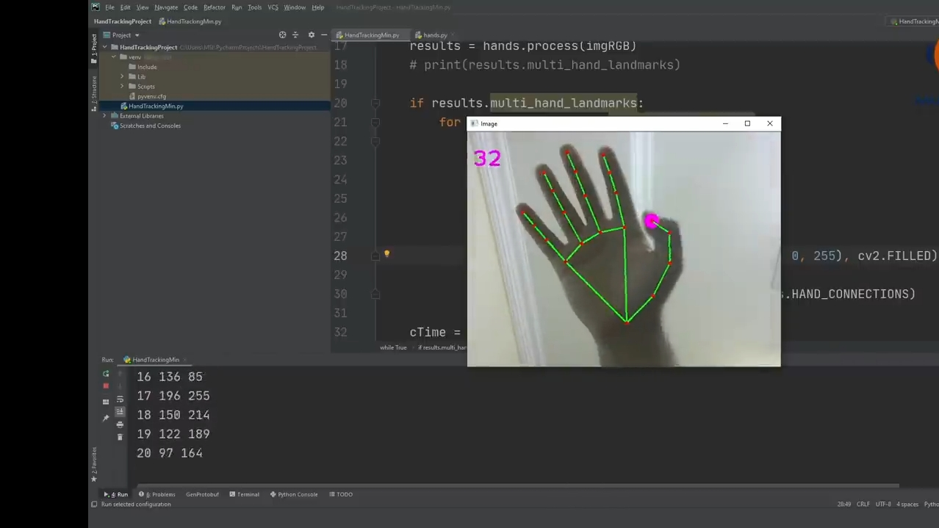
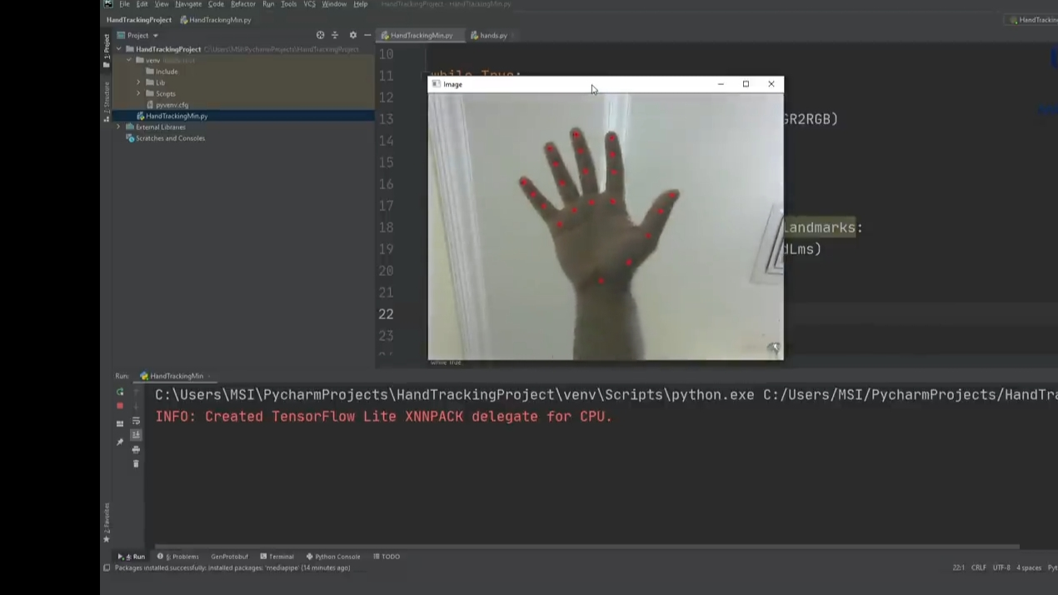
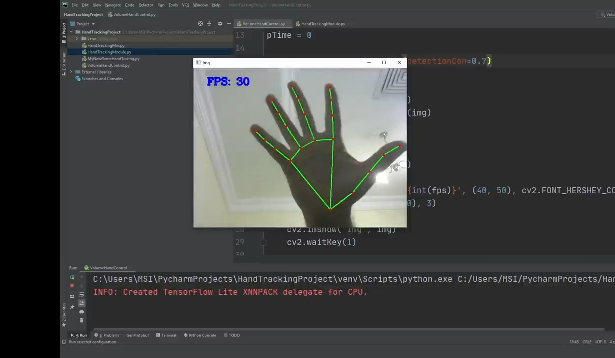
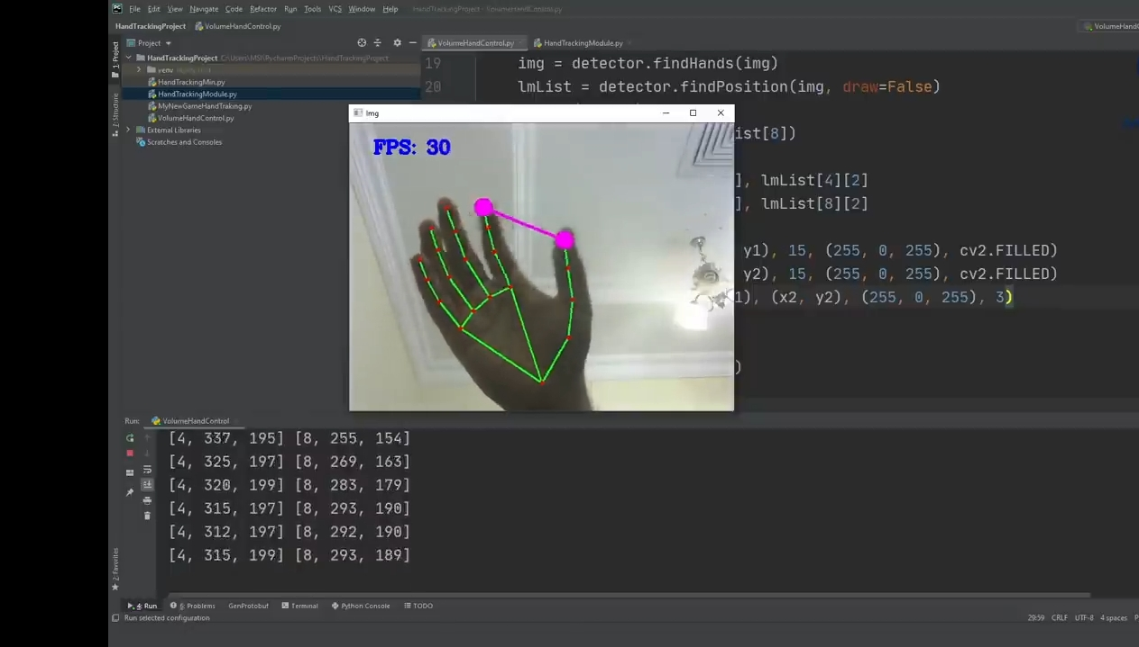
Result Images:-

Slide 10
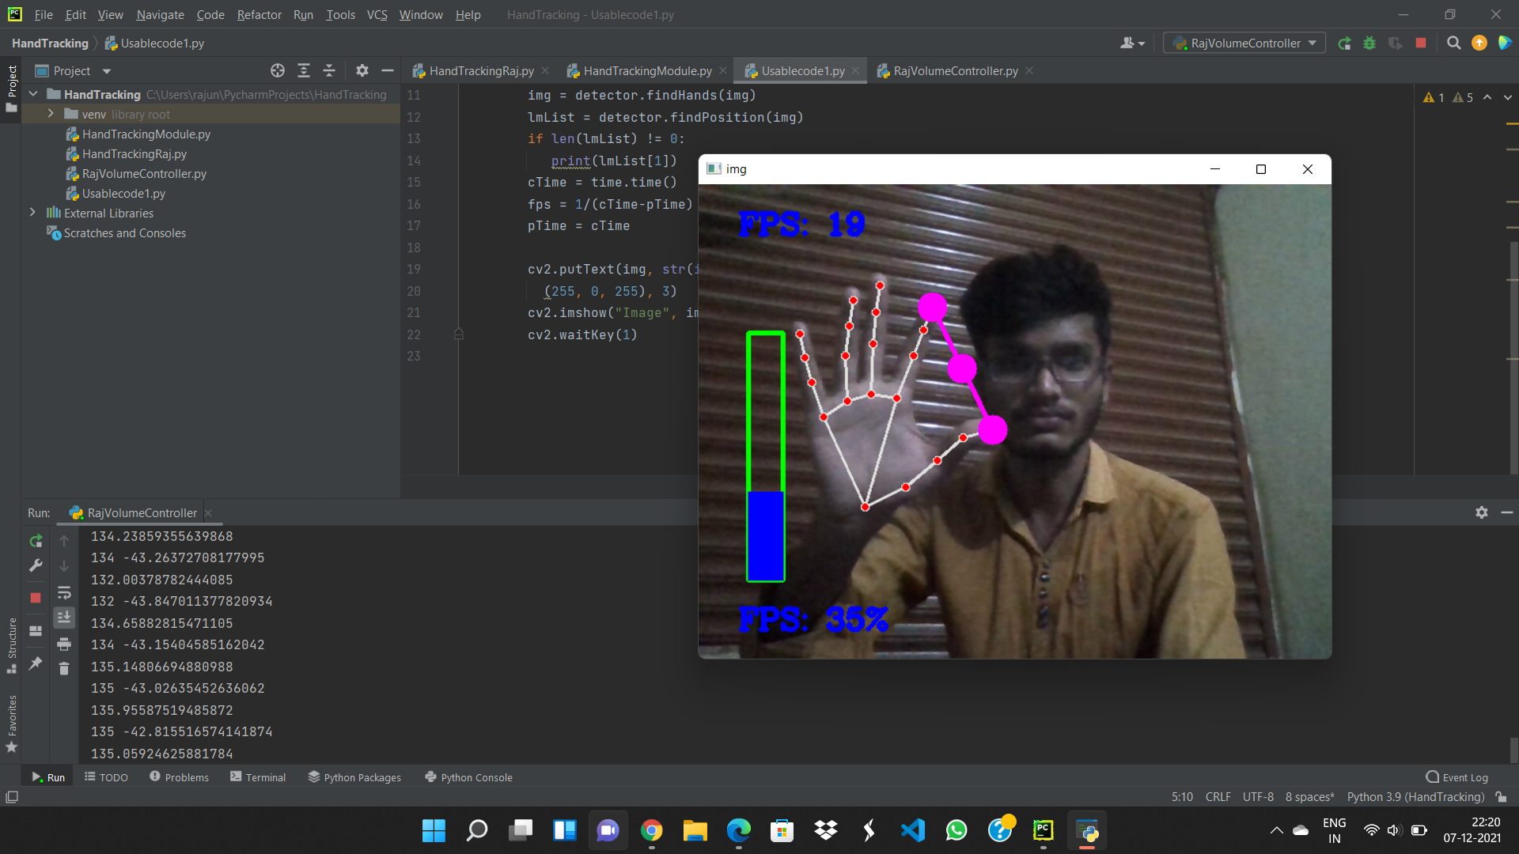

Slide 11
CONCLUSION
The project presented a program that allowed user to perform hand gestures for easy software control. A vision-based hand Gesture system that does not require any special markers or gloves and can operate in real-time on a commodity PC with low-cost cameras. Specifically, the system can track the tip positions of the counters and index finger for each hand. The motivation for this hand Gesture was a desktop-based volume control system in which a user can control volume and cursor navigation in realtime using natural hand motions.

Slide 12
THANK YOU

